Slide 1
Travel Insurance

Slide 2
Problem Statement
So here we have to predict which claims need to sanctioned .
The possible business problem is that if we wrongly deny a genuine claim that could lead to lawsuits against the company.
Notes:
Can we include some examples here?

Slide 3
Why solve this problem?
Why solving this problem is important? - Business Impact
Automatically predicting the claims could lead to a lot of benefits such as we would have an idea which factors are mainly considered for claim approval and fraudulent claim approval can be avoided.
Who are the stakeholders for whom you are presenting the solution? - CEO, CFO, Marketing, Sales etc
CEO of Travel Insurance Firm
Any important assumptions you are making.
We expect the presence of outliers and those must be genuine one’s,which should not be treated as we might generalize the column and eradicate the data if we do so.
Negative outliers should be ignored because they are negligible in numbers

Slide 4
Data
What are the data points you currently have in the dataset?
Target: Claim Status (Claim.Status),Name of agency (Agency),Type of travel insurance agencies(Agency.Type),Distribution channel of travel insurance agencies (Distribution.Channel),
Name of the travel insurance products (Product.Name),Duration of travel (Duration),Destination of travel(Destination),Amount of sales of travel insurance policies (Net.Sales),The commission received for travel insurance agency (Commission),Gender of insured (Gender),Age of insured (Age)
If you had the opportunity, what additional data you would love to have?
Some of the additional columns are :- Proof_of_Claim , Number_of_bookings_per_person, Prior_Claims_Info, Booking_Amount

Slide 5
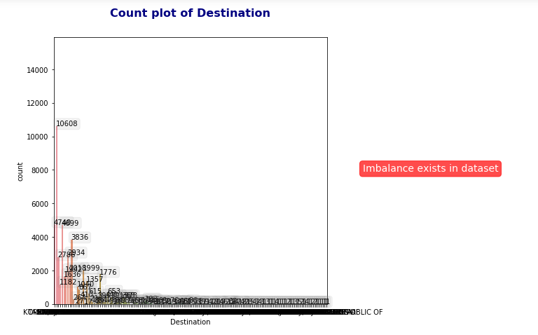
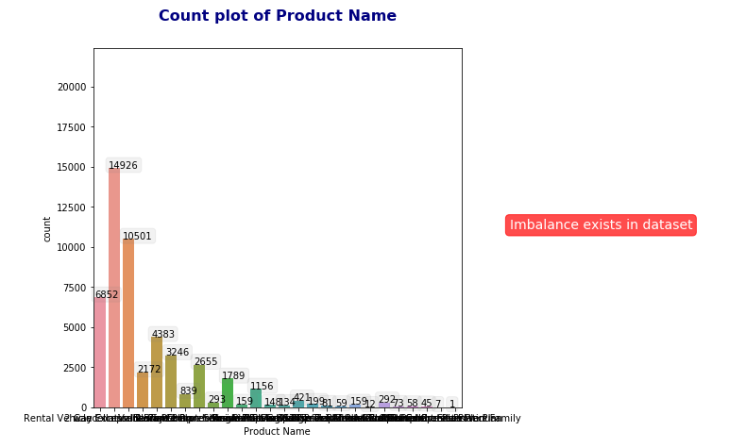
Exploratory Data Analysis
Put across the EDA that is most interesting and relevant to the problem.
For each of the Data visualizations being showcased, put the business relevant insight, and bring out how are you using this insight later in problem solving.
Put the most insightful 2-3 data visualizations and rest of EDA summarize. Let jupyter notebook stay as is, this is a crisp summary ONLY

Slide 6
Feature Engineering
As we observed in previous slide, Destination Column was left scewed and alot of similar data information could have been considered as same(the one which lies in the tail of skewness).So we introduced “Others”.
Others contained all the country names which has less than one percent of probability of sanctioned claims.
Dummified the categorical columns using One Hot encoding which did not priotize the values and aslo converted them into numbers

Slide 7
Models and Approaches
What are the different models you tried?
We did try Logistic Regression, Random Forest Classifier,Linear SVC, Gradient Boosting with four sampling methods RandomUnderSampling, RandomOverSampling and SMOTE.
For the best performing model, any insights on why it performed well.
The best one was Gradient Boosting Classifier with SMOTE..

Slide 8
Model Tuning
Any additional hyperparameter tuning you have done?
We did try Random Forest Classifier with GridSearch. We also used Gini Index and Entropy but the results were not as satisfactory as we got for Logistic regression with SMOTE.
Any feature selection/feature engineering that you have done to improve the results?
We coverted the categorical columns to numerical by providing count as weight to the columns.

Slide 9
Evaluation & Results
The metric used is confusion matrix in which we are referring to Precision and Recall.
The selected metric was precision score because precision calculates :
True Positive/True Positive + False Positive
(Here : TP = Claim accept and genuine , FP = approving the wrong claim would lead to loss)
We think recall should be considered because wrongly denying a genuine claim could lead to lawsuits against the company which is fatal.
Here , Recall = TP / TP + FN , FN = Wrongly denying a genuine claim)
Precision indicates that How often our predictions are correct.
Recall indicates that When it’s actually Yes, how often does it predicts Yes.

Slide 10
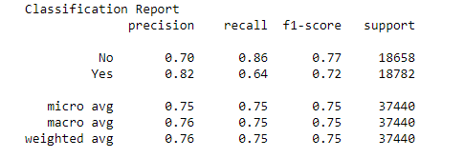
Final Results
Our final results were :
For the model we finally selected.

Slide 11
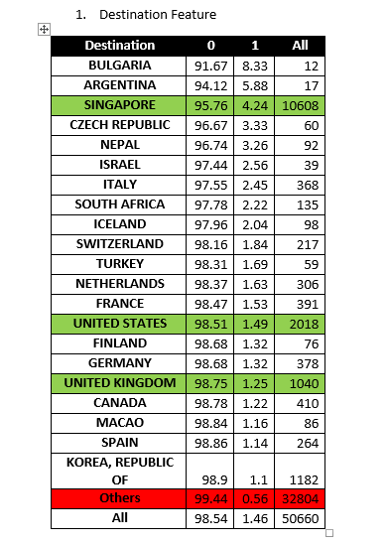
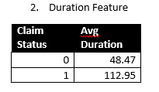
Insights & Decisions

Slide 12
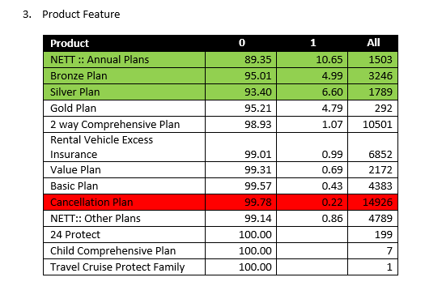
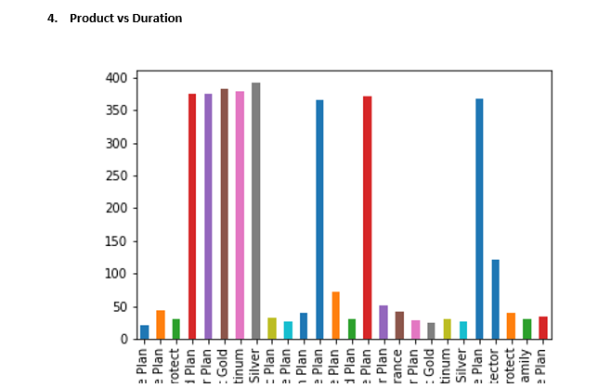
Insights & Decisions

Slide 13
Insights & Decisions
SINGAPORE, UNITED STATES and UNITED KINGDOM are the countries where probability of claims getting sanctioned is higher(With Significant base) as compared to other countries.
It seems that the person taking insurance for longer duration has higher probability of getting loan sanctioned.
The Annual plans has the highest probability of Claims getting sanctioned. If we look further into Annual Plans then we will find that among the annual plans ‘Annual Silver Plan’ has the highest probability with 11.07% with the base of 1156.
Annual plans are with highest term duration. So our assumption of claim of Highest duration plans getting sanctions seems to be correct.

